Slide 1

Vel Tech Rangarajan Dr. Sagunthala R&D Institute of Science and Technology
School of Computing
Department of Computer Science and Engineering
10211CS224 / FULL STACK APPLICATION DEVELOPMENT (JAVA)
PROJECT REVIEW : MILESTONE PROJECT – 2
Date: 20\04\2026
Smart Campus Event Management System
SDG 4,9 – Quality Education, Industry Innovation and Infrastructure
Presented By:
A.DHANUNJAYA – VTU25920–23UECS0644
.
Courses Handling Faculty:
Dr.S.HEMAMALINI-M.E.,Ph.D.,

Slide 2
INTRODUCTION
Campus events like workshops, seminars, and technical programs are conducted regularly in colleges. Managing these events manually is difficult and time-consuming.
Students often do not get proper information about events. Admins also struggle to track registrations and event details.
This project provides a simple web-based system where:
• Students can view and register for events • Admin can manage events easily • All data is stored securely in a database
The system is built using Spring Boot and follows MVC architecture.
1
2
3
4
5
6
7
8
9

Slide 3
PROBLEM STATEMENT
In many colleges, event management is done manually or using basic tools.
Problems include: • No centralized system • Difficulty in tracking registrations • Manual errors • Lack of real-time updates • No proper statistics
There is a need for an automated web application that manages events efficiently and securely.
1
2
3
4
5
6
7
8
9

Slide 4
OBJECTIVE(S)
1
2
To design and develop a web-based Smart Campus Event Management System.
To implement secure admin management and student registration using Spring Boot and JPA.
3
4
5
6
7
8
9

Slide 5
PROPOSED SYSTEM
Here proposed system is a web-based application that allows:
• Admin to create, update, delete events • Students to browse and register for events • Secure admin login using Spring Security • Data storage using H2 database • Form validation for user inputs • Event registration tracking
Advantages: • Fully automated system • Secure authentication • Easy to use interface • Real-time database updates • Simple and scalable architecture
1
2
3
4
5
6
7
8
9

Slide 6
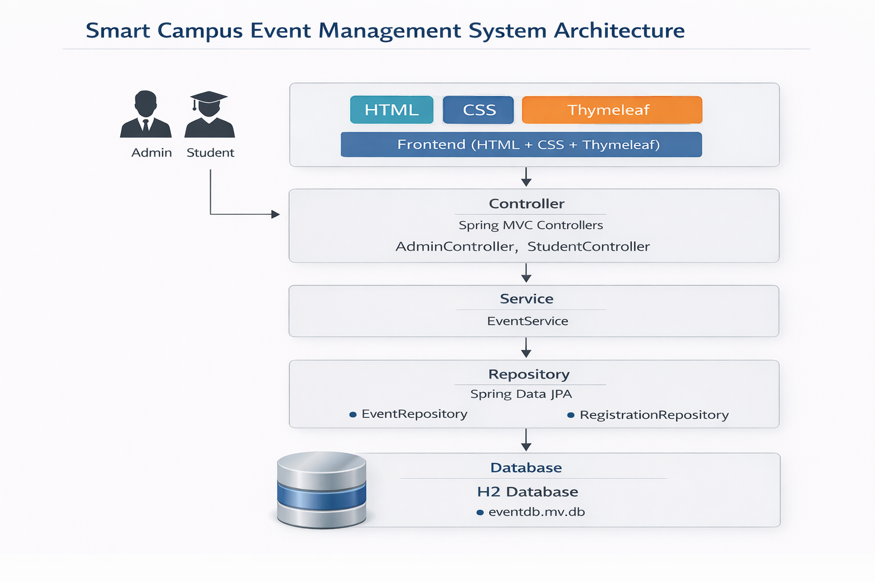
PROPOSED SYSTEM ARCHITECTURE
(Insert block diagram) -
Explain:
Input
Processing
Database
Output
1
2
3
4
5
6
7
8
9

Slide 7
PROPOSED SYSTEM ARCHITECTURE
User Layer (Browser)
This layer represents the Admin and Students who access the system through a web browser to manage and register for campus events.
Presentation Layer (HTML + CSS + Thymeleaf)
This layer provides the user interface of the application, displaying event details, forms, dashboards, and success messages using Thymeleaf templates.
Controller Layer (Spring MVC)
The Controller layer handles incoming HTTP requests, processes user actions, and connects the frontend with the backend logic using AdminController and StudentController.
Service Layer (EventService)
This layer contains the business logic of the application, such as saving events, fetching event lists, and processing registrations.
Repository Layer (Spring Data JPA)
The Repository layer communicates with the database and performs CRUD operations using EventRepository and RegistrationRepository.
Database Layer (H2 Database)
This layer stores all event and registration data securely in the H2 database file (eventdb.mv.db).
1
2
3
4
5
6
7
8
9

Slide 8
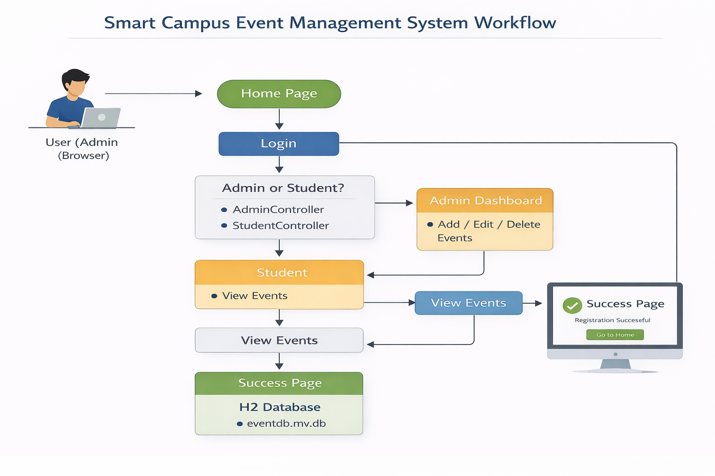
WORKFLOW
1
2
3
4
5
6
7
8
9

Slide 9
TECHNOLOGIES USED
Frontend: • HTML5 • CSS3 • Thymeleaf
Backend: • Spring Boot • Spring MVC • Spring Core
Database: • H2 Database (eventdb.mv.db)
Security: • Spring Security (Basic Authentication)
Tools: • Eclipse IDE • Maven • Embedded Tomcat
1
2
3
4
5
6
7
8
9

Slide 10
MODULE DESCRIPTION
Module 1: Admin Management Handles login and event management operations like add, edit, delete.
Module 2: Student Module Allows students to browse and register for events.
Module 3: Service Layer Implements business logic using EventService.
Module 4: Database Module Stores event and registration details using JPA and H2 database.
Module 5: Security Module Implements authentication using Spring Security.
1
2
3
4
5
6
7
8
9

Slide 11
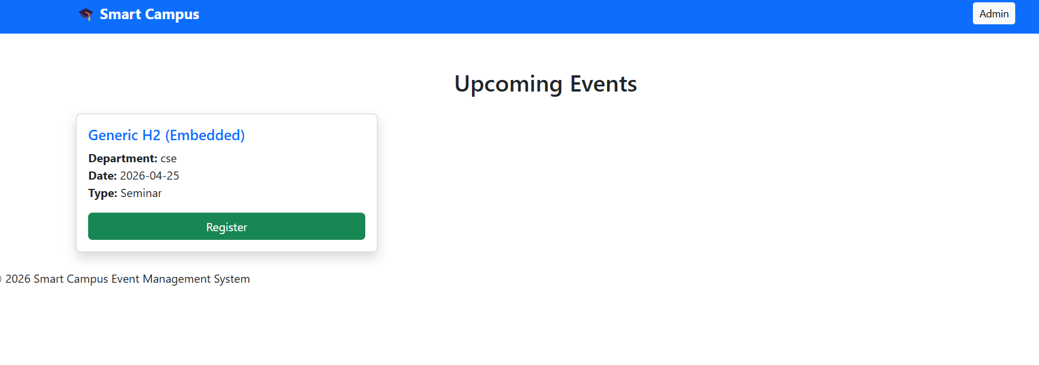
IMPLEMENTATION SCREENSHOTS
1
2
3
4
5
6
7
8(A)
Home Page: This is the landing page of the system.
9

Slide 12
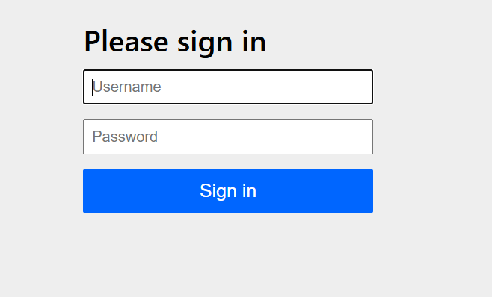
IMPLEMENTATION SCREENSHOTS
1
2
3
4
5
6
7
8(B)
Admin Login Page: Admin logs in using secure authentication.
9

Slide 13
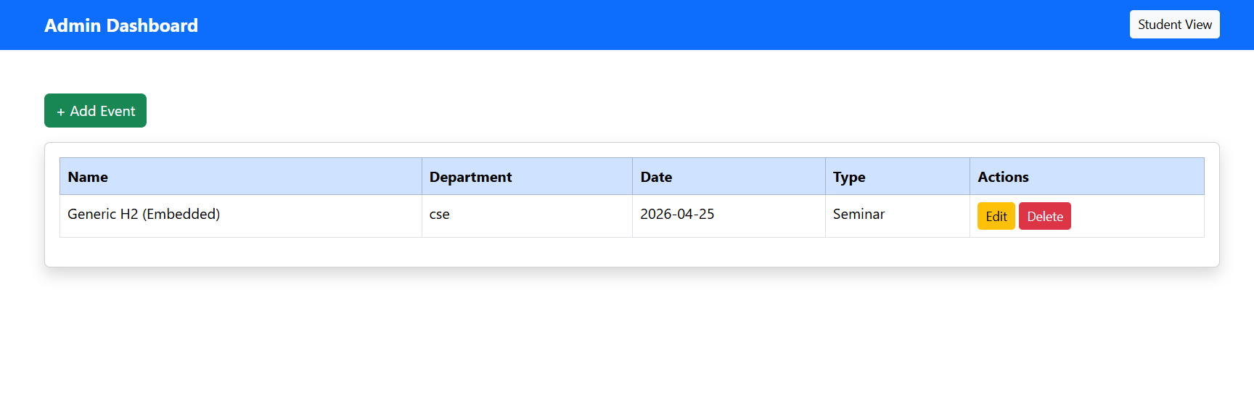
IMPLEMENTATION SCREENSHOTS
1
2
3
4
5
6
7
Admin Dashboard
Explain: Admin can manage events here.
Student Events Page
Explain: Students can view available events.
Registration Page
Explain: Students enter details to register.
8(B)
9

Slide 14
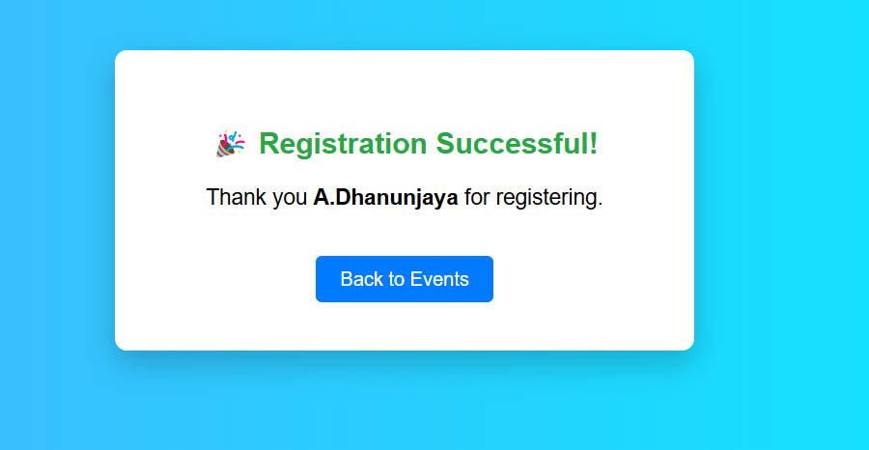
IMPLEMENTATION SCREENSHOTS
1
2
3
4
5
6
7
8(C)
Success Page
Shows successful registration message.
9

Slide 15
ADVANTAGES & LIMITATIONS
1
ADVANTAGES
• Simple and user-friendly • Secure admin access • Fast and lightweight • Easy database management • Real-time data storage • Scalable for future improvements
LIMITATIONS
• Uses H2 database (not production database) • Basic UI design • Single admin login • No email notification feature
2
3
4
5
6
7
8
9

Slide 16
Thank you

